Slide 1

PRINCIPLES OF MANAGEMENT

Slide 2
PROJECT
IMPACT OF SOCIAL MEDIA

Slide 3
OVER VIEW
ABSTRACT
INTRODUCTION
SOCIAL NETWORKING SITES
USES
IMPACT OF SOCIAL MEDIA
SURVEY
METHODS
CONCLUSION

Slide 4
ABSTRACT
Social Media plays a very important role in the life of everyone. Billions of people around the world use social media to share information and make connections.
It is easy to connect with people but the communication between people gets reduced. Social media has both positive and negative impact on the youth. Youth can be defined as a time of life when one is young, it is a period between childhood and adult age.

Slide 5
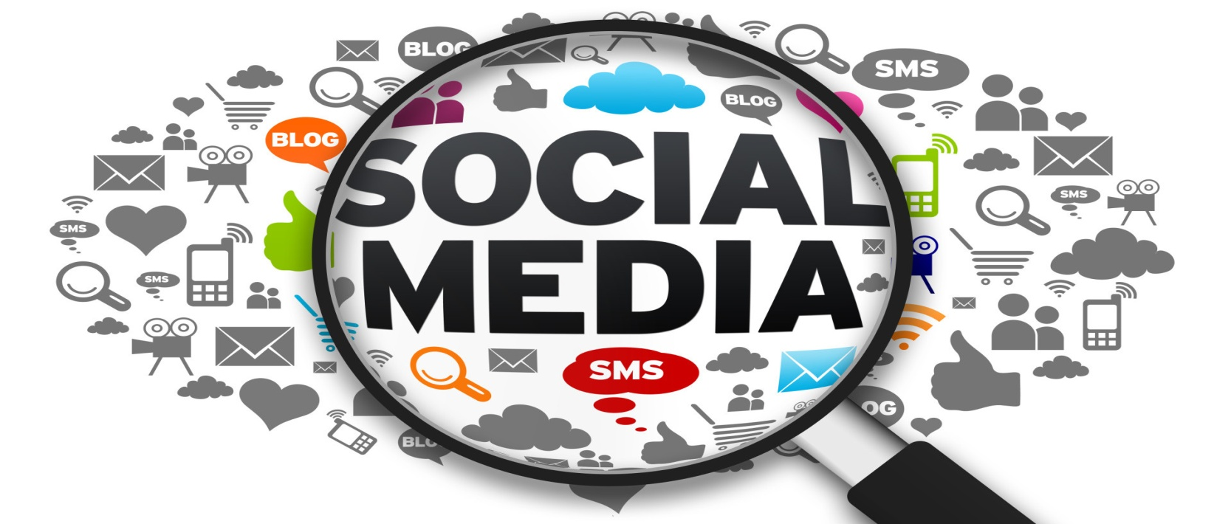
introduction
Social Media is the collection of online communication channels.
It is dedicated to community-based input interaction content sharing and collaboration.

Slide 6
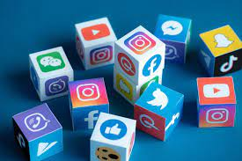
LIST OF SOCIAL NETWORKING SITES
Facebook
Twitter
YouTube
Instagram
WhatsApp
Linkdin, etc.

Slide 7
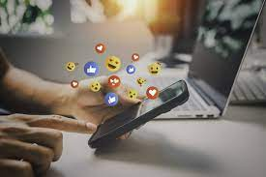
USES OF SOCIAL MEDIA
To stay in touch with what friends are doing.
To stay upto date with news and current events.
To fill up spare time.
To find funny or entertaining content.
To share opinions.
Social media make lives of many easier

Slide 8
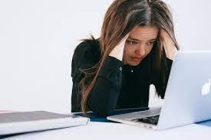
IMPACT OF SOCIAL MEDIA
It impacts on
Health
Education
Youth
Society

Slide 9
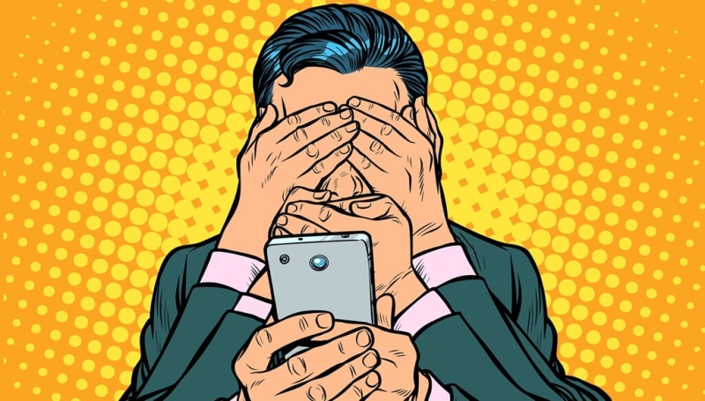
IMPACT OF SOCIAL MEDIA ON EDUCATION
It impacts on education of a student by distracting them from studies and destroying them.
It makes a student dull and lazy
Time spent on social media is higher than the time spent with other persons.
This results in emotional imbalance of a student

Slide 10
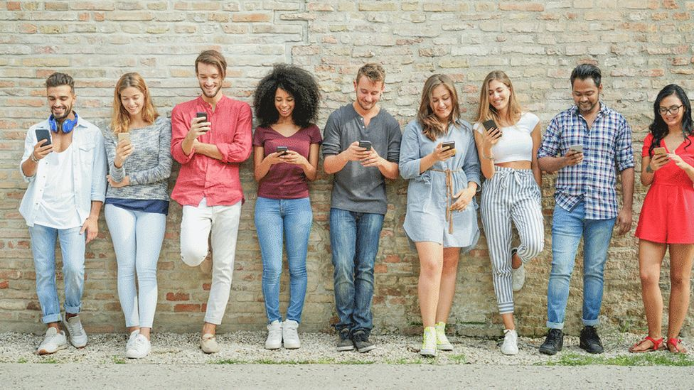
IMPACT OF SOCIAL MEDIA ON SOCIETY
Communications are reduced due to social media platforms.
Technology has come a long way from its existence.
Social media make lives of many easier
With social media any person has ability to be a big deal and can influence other

Slide 11

IMPACT OF SOCIAL MEDIA ON POLITICS
Voter participation is increased. Facebook users are said they are more likely to vote if they see that their online friends did.
Online networks give social movements a quick, cheap method of disseminating information and mobilizing people.

Slide 12
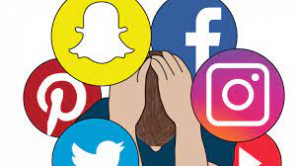
IMPACT OF SOCIAL MEDIA ON HEALTH
As we know social media is destroying our mental health conditions like
Stress
Emotional connection
Addiction to social media.

Slide 13
LITERATURE SURVEY
SABITA MAHAPATRA(2016)
RAVI PRAKASH SINGH(2016)
NOOR AZUAN HASHIM ET AL (2016)
THOMS, ERYILMAZ
GERBINO

Slide 14
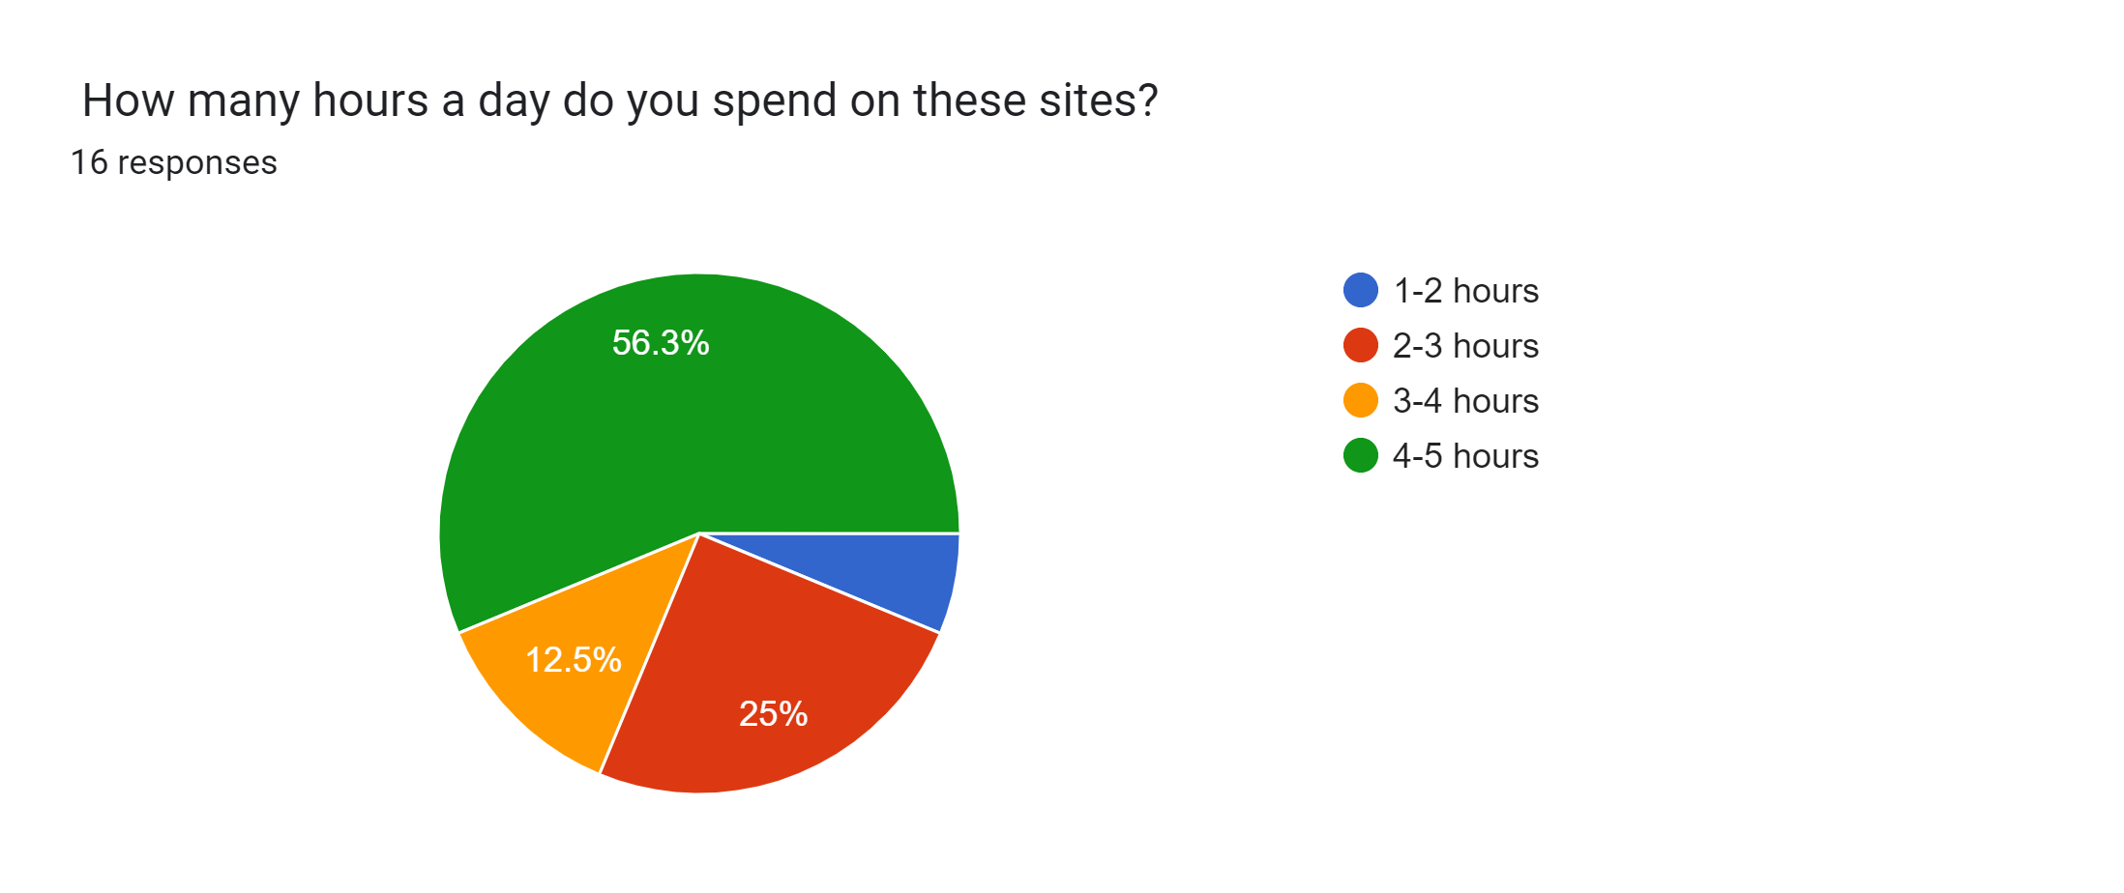
SURVEY
According to a survey, most of the people are spending most of their time on social media.

Slide 15
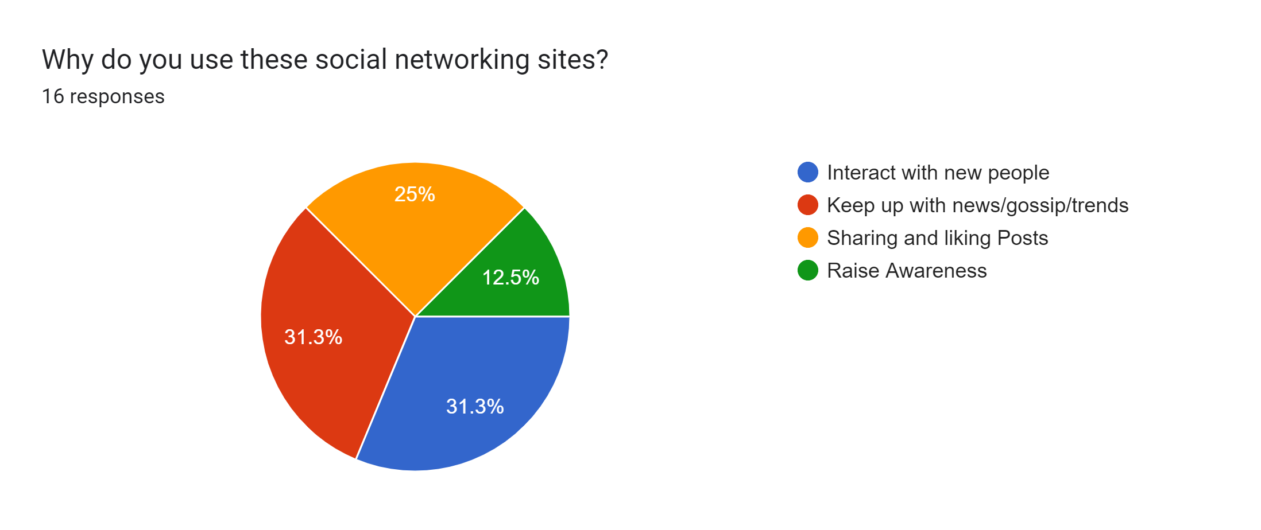
Most of the people use social media to interact with people and not to gain the knowledge

Slide 16
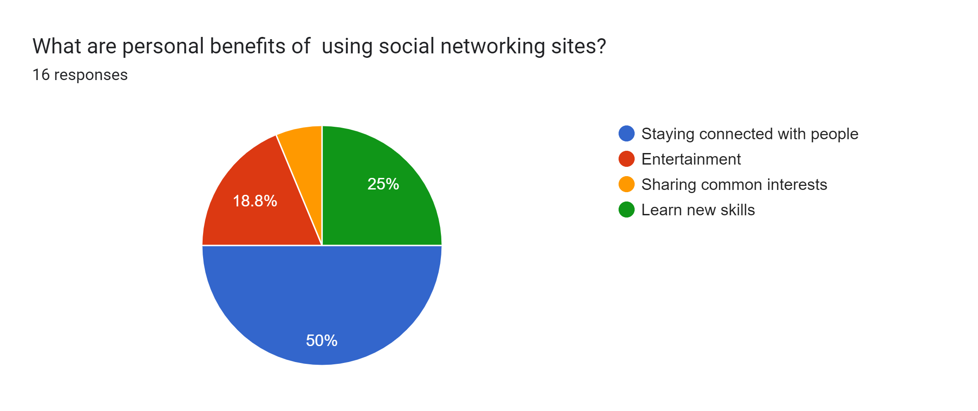
According to this survey most of the people feel the personal benefits of using social media is to stay connected with people.

Slide 17
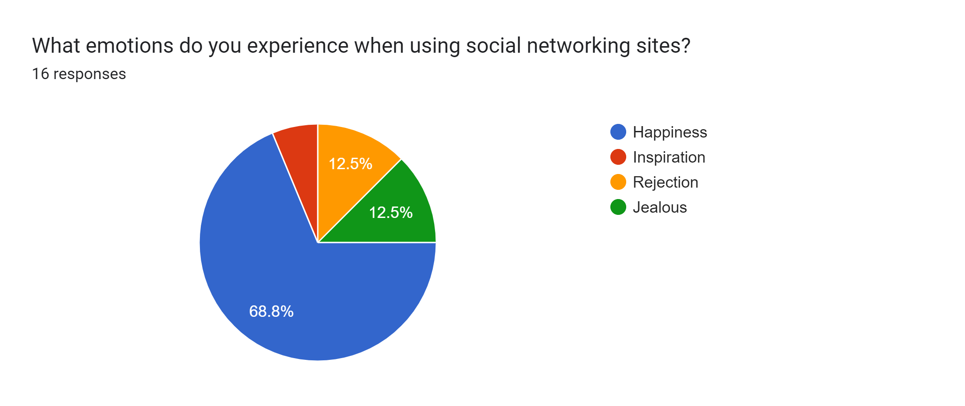
Everyone think that using social media gives them happiness instead it is affecting our lives

Slide 18

METHODS TO REDUCE IMPACT
There are certain methods to reduce this impact
Turn Off All app-based Notifications
Delete Apps / Social Media Accounts You Don’t Use
Limit Yourself
Avoid sleeping with mobile
Remove your phone from your morning routine
Take a break

Slide 19
CONCLUSION
As with most of the things in life there are positive and negative sides to social networking, both of which we have now explored. Our ultimate belief is that social networking sites are neither evil or godsend.

Slide 20


Slide 21
PRESENTED BY
T. S. MIZBA,
(192110569)
T. ABHINAYA,
(192110497)

